Slide 1
CA LAB (11) DC MOTORS

Slide 2
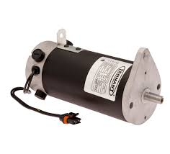
Electric Motor
An electric motor is an electrical machine that converts electrical energy into mechanical energy
Most electric motors operate through the interaction between the motor's magnetic field and electric current in a wire winding to generate force in the form of torque applied on the motor’s shaft.

Slide 3
Principle of Electric Motor
The principle of electric motor is when a current carrying conductor is placed in a magnetic field it experiences a force.
Note: The basic principle of electric motor and generator are same.

Slide 4
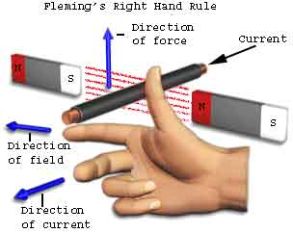
Fleming Left Hand Rule

Slide 5
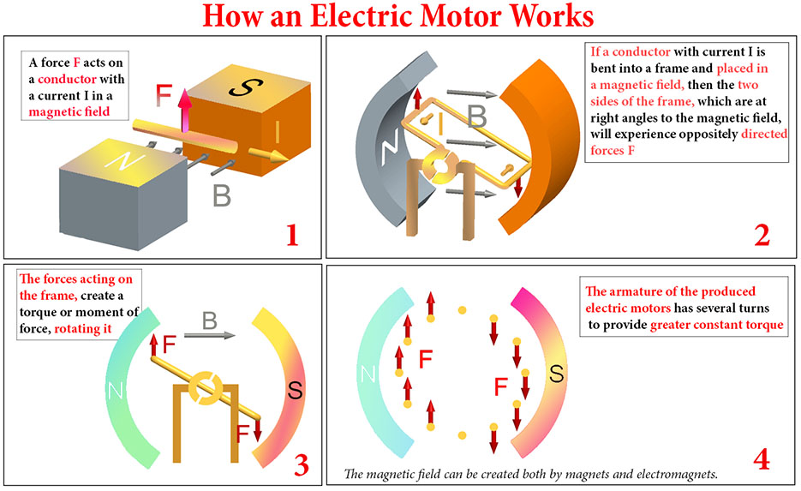

Slide 6
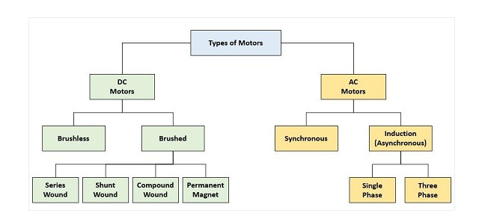
Types of Motors

Slide 7
Parts of a Motor
The Stator
The Rotor
Armature
The Commutator: Basics
Brushes and Terminals

Slide 9
Motor Parameters
Power
Voltage Rating
Current
Torque
RPM
Stall Current

Slide 10
PWM (Pulse Width Modulation)
Pulse Width Modulation, or PWM, is a technique for getting analog results with digital means.
Digital control is used to create a square wave, a signal switched between on and off.
This on-off pattern can simulate voltages in between full on (5 Volts) and off (0 Volts) by changing the portion of the time the signal spends on versus the time that the signal spends off. The duration of "on time" is called the pulse width.

Slide 11
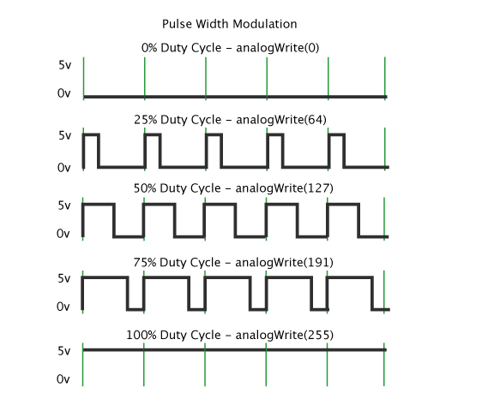

Slide 12
PWM in Arduino
There are six pins in UNO which can generate PWM signal.
Syntax “analogWrite(pin NO, value)”
Max value is 255

